Slide 1
Build a Vision Model, Then Break It
UNIVERSITY WORKSHOP · 1 AND 2 NOVEMBER 2026
Train a chest X-ray classifier in your browser, then find out when and why it fails.
Educational only. Not for clinical use.
Samir Akram Ounis
Notes:
Welcome everyone. Over two days we will do something unusual for an AI course: we build a medical image classifier in about four seconds, and then we spend most of our time trying to break it. By the end you will know why a high score is never the end of the story. Timing: this is the opening of Day 1, about 1 h 50 in total; suggested pace is roughly 15 minutes of introduction and hook, 25 of concepts, 12 on data, 15 on metrics and 35 hands-on in the app. Mention clearly now that everything is educational only and not for clinical use.

Slide 2
About me
DAY 1 · WELCOME
Samir Akram Ounis
ROLE
AFFILIATION
I WORK ON
AI & Software Engineer
Founder & Ex-President
Vesion, LLMs, Software
Why this workshop: a model can score well and still fail on the first patient it has not seen. We train one, then try to break it.
Build a Vision Model, Then Break It · Educational only. Not for clinical use.
02
Notes:
Introduce yourself in under a minute: who you are, where you work and what you work on. Then say why this workshop exists: the easy part of machine learning is getting a good number, the hard part is finding out whether you can trust it. Tell them they will leave with a habit, not just a model.

Slide 3
The two days at a glance
DAY 1 · PLAN
 | Day 1 · 1 November | Day 2 · 2 November
Theme | Train it, then doubt it | Shortcuts, shift and the human in the loop
Length | About 1 h 50 | About 1 h 50
Setup | Nothing to install | Same app, same browser
It all runs in your browser. Open the app at
https://akramoo.github.io/vision-break-workshop/
Build a Vision Model, Then Break It · Educational only. Not for clinical use.
03
Notes:
Day 1 is about building and measuring: the ideas, the data, the metrics, then training your first model and starting to break it. Day 2 is about why it breaks: shortcuts, new populations, fixes, and where a human has to stay in charge. Each day is about one hour fifty. Nothing to install: everything runs in the browser, and X-rays never leave your computer. Show the app link now so people can open it in another tab.

Slide 4
By the end you can…
DAY 1 · GOALS
1
Explain supervised learning and transfer learning in one sentence each
2
Train an image classifier and read accuracy, sensitivity, specificity and a confusion matrix
3
Show that a high test score can hide class imbalance, shortcuts and population shift
4
Apply two fixes and re-measure on every test set
5
Say where a human must stay in the loop, and why
Build a Vision Model, Then Break It · Educational only. Not for clinical use.
04
Notes:
These are the five things you should be able to do at the end of Day 2 that you could not do when you walked in. Read them quickly; we come back to the same list in the quiz at the end, so you can see what changed. Point out that outcomes 3 to 5 are not about maths. They are about judgement.

Slide 5
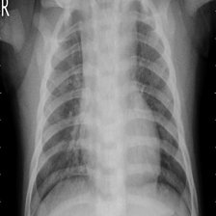
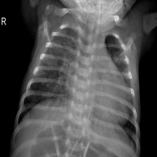
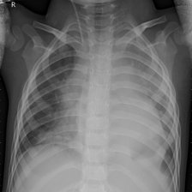
Which of these have pneumonia? Hands up.
DAY 1 · WARM-UP
A
B
C
Build a Vision Model, Then Break It · Educational only. Not for clinical use.
05
Notes:
Timing for the warm-up: about 10 minutes, slides 5 to 7: the hook, what a general chatbot said, then the reveal. Show A, B and C and ask for a show of hands for each: who thinks this one has pneumonia? Two of the three do. Do not give any hint. These three were chosen on purpose: they are the cases our AI model finds hardest on the official test set, so a wrong human guess is no shame. Many people will vote with confidence, which is exactly the point. Then, if you prepared it, ask a chatbot the same question with the same images before moving on. The next slide shows what a general chatbot said, without any truth, and the true labels come on the slide after that. Do not reveal them yet.

Slide 6
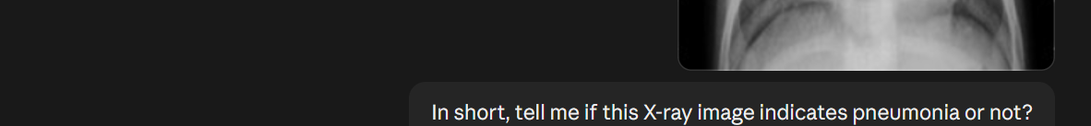
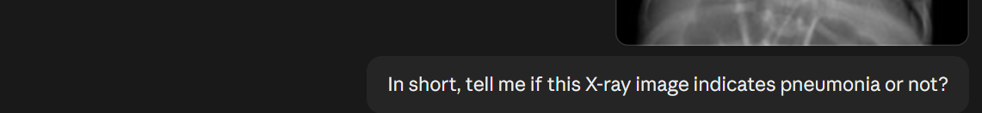
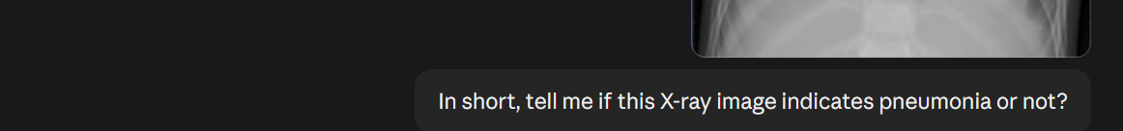
What a general chatbot said
DAY 1 · WARM-UP
A
B
C
Claude Opus 5.5, image only, same question for each image. One run each: answers vary between runs.
06
Notes:
Before you show anything else: ask the room to guess what the chatbot answered for A, B and C. Then let them read the first line of each reply. The question was "In short, tell me if this X-ray image indicates pneumonia or not?", same for all three images. The chatbot leaned toward pneumonia on all three and hedged on every one: "not confident" for A, "harder to call" for B, "only moderately confident" for C. No truth is shown on this slide. Do not reveal the labels yet; they come on the next slide, together with what our own AI model said. This was one run each, and answers vary between runs.

Slide 7
What the chatbot said, and the truth
DAY 1 · WARM-UP
WHAT THE CHATBOT SAID
A
Truth: normal
A
Pneumonia, not confident: wrong
B
Truth: pneumonia
B
Pneumonia, hedged: right
Pneumonia, moderately confident: right
C
Truth: pneumonia
C
Build a Vision Model, Then Break It · Educational only. Not for clinical use.
07
Notes:
Reveal: A is normal, B is pneumonia, C is pneumonia, according to the dataset labels (Kermany test set, graded by physicians). Ask who was right, then recall what the chatbot said on the previous slide, then what our own AI model said. These three are the model's hardest cases on the official test set, so a wrong human guess is no shame. A has a big R marker at the left edge, and the model leaned on markers: it is about 100 percent sure of pneumonia on a normal child, a false alarm. B is a missed sick child: the model says normal at only 23 percent chance of pneumonia, and low sensitivity costs more than a false alarm. C shows the model is nearly guessing: pneumonia at 51 percent. Whatever the result, make the point: confident answers are cheap, and nobody in the room can tell from the outside whether they are reliable. Over the next two days we learn how to measure that. The chatbot got A wrong (A is normal), just like our model: both the chatbot and our small model were fooled by A. The point is reliability, not one answer. B and C the chatbot got right, but hedged, while our model missed B and was barely right on C.

Slide 8
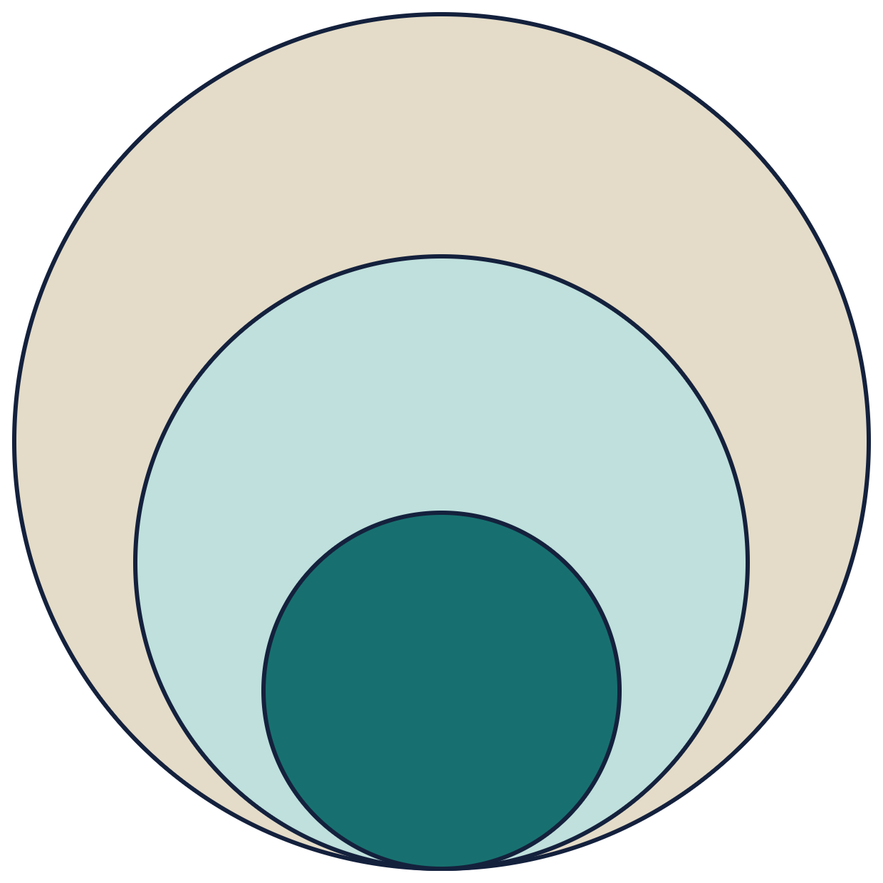
AI, machine learning and deep learning
DAY 1 · CONCEPTS
THE GOAL
Artificial intelligence
AI: machines that do things that normally need human intelligence.
Machine learning
THE METHOD
ML: the computer learns from examples instead of hand-written rules.
Deep learning
THE TOOL WE USE
DL: machine learning with neural networks that have many layers.
Build a Vision Model, Then Break It · Educational only. Not for clinical use.
08
Notes:
Timing: the concepts block, slides 8 to 15, takes about 25 minutes. Read the picture from the outside in. AI is the goal, any technique that makes a machine behave intelligently. Machine learning is one way to get there: the machine learns from examples. Deep learning is machine learning using neural networks with many layers, and that is what we use for images. Everything we do in this workshop sits in the smallest circle.

Slide 9
Rules versus learning, and what an image is
DAY 1 · CONCEPTS
12
18
25
22
15
10
WRITING RULES
Nobody can write a rule for “cloudy lung”.
20
96
140
128
90
14
31
150
210
190
120
22
LEARNING FROM EXAMPLES
28
160
235
220
140
26
So we show the computer thousands of labelled X-rays and let it find the pattern.
18
110
170
160
100
16
8
14
22
20
12
6
An X-ray is a grid of brightness values, 0 (black) to 255 (white). Illustrative 6 × 6 patch.
Build a Vision Model, Then Break It · Educational only. Not for clinical use.
09
Notes:
Ask the room how they would write an if-then rule for pneumonia. Pause. Nobody can, because cloudiness is a pattern, not a threshold. So instead of writing the rule, we show examples and let the computer find the pattern. On the right: what the computer actually sees. A picture is just a grid of numbers, brightness from 0 for black to 255 for white. The values here are illustrative, a tiny 6 by 6 patch; a real X-ray in our app is 224 by 224 of these.

Slide 10
Machine learning versus deep learning
DAY 1 · CONCEPTS
 | Classic machine learning | Deep learning
Who designs the features? | A person chooses what to measure | The network learns what to look at
Data needs | Can work with small datasets | Usually needs much more data
Typical example | Hand-picked measurements and a decision tree | A convolutional network reading pixels
When to use it | Small tables of numbers, simple to explain | Images, sound and text, with lots of data
Our model: a pre-trained deep network plus a small classifier we train.
Build a Vision Model, Then Break It · Educational only. Not for clinical use.
10
Notes:
The key difference is who does the feature design. In classic machine learning a person decides what to measure, such as edge sharpness or lung area, and a simple model uses those numbers. In deep learning the network learns its own features directly from the pixels, which is powerful but data hungry. That is why we will not train a deep network from scratch today: we reuse one that is already trained. The rules of thumb on this slide are simplifications, so say so if a student pushes back with a counter example.

Slide 11

Supervised learning
DAY 1 · CONCEPTS
1 · TRAINING, ONCE
Examples + answers
Training
A function comes out
Thousands of X-rays, each with its correct label
The computer adjusts itself until its answers match the labels
It maps any image to an answer
2 · USING IT, EVERY TIME
A new X-ray
The learned function
An answer
Never seen before
The same one that came out of training
Pneumonia or normal, with a confidence
Build a Vision Model, Then Break It · Educational only. Not for clinical use.
11
Notes:
Supervised means supervised by labels. Top row: we give the computer examples together with the correct answers, and it adjusts itself until its answers match. What comes out is a function: give it an image, get an answer. Bottom row: that same function is then used on new images it has never seen. The quality of the labels sets the ceiling, which is why we spend time on where our labels come from.

Slide 12
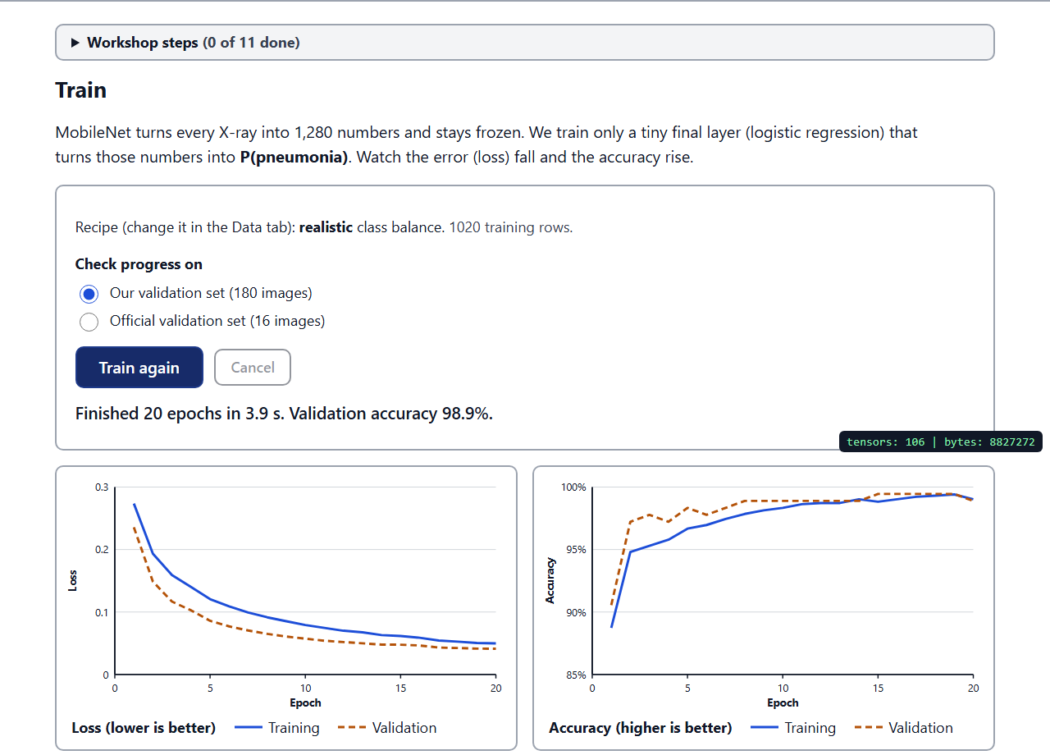
How a network learns
DAY 1 · CONCEPTS
WHAT YOU WILL SEE IN THE APP
1
Guess
Layers of weighted sums turn the pixels into a probability.
2
Measure the error
The loss says how far the guess is from the label.
3
Nudge the weights
Change each weight a little to shrink the error, like a ball rolling downhill. Repeat.
Build a Vision Model, Then Break It · Educational only. Not for clinical use.
12
Notes:
A neural network is layers of simple calculations: multiply the inputs by weights, add them up, pass the result on. Training is a loop. Guess, measure how wrong the guess was, nudge every weight slightly in the direction that makes the error smaller, then repeat. Picture a ball rolling downhill on an error landscape. On the right is what you will see in the app: the loss curve falls and the accuracy curve rises, over 20 rounds called epochs. In the app this takes about four seconds.

Slide 13

What is a CNN?
DAY 1 · CONCEPTS
Textures
1,280 numbers
Image
Edges
Shapes
A 224 × 224 grid of pixels
Early layers find lines and borders
Middle layers find repeating patterns
Later layers find parts and outlines
A summary of the whole X-ray
A convolutional neural network slides small filters over the image. Each filter responds to one pattern.
This is the layer stack inside MobileNet v2.
Build a Vision Model, Then Break It · Educational only. Not for clinical use.
13
Notes:
CNN stands for convolutional neural network. The idea is a small filter, for example three pixels by three, that slides across the whole image and lights up wherever it sees its pattern. Early layers find simple things like edges. Later layers combine them into textures and then shapes. At the end the whole X-ray has been summarised as 1,280 numbers. That stack of layers is what is inside MobileNet v2, the network we use in the app. Notice we never tell it what an edge or a shape is: it learned that from data.

Slide 14
What is a foundation model?
DAY 1 · CONCEPTS
A large model pre-trained on broad data, then reused for many different tasks.
OUR MODEL
THE LARGE-SCALE VERSION
MobileNet v2
Chatbots like GPT-4o
A small pre-trained network, trained on ImageNet’s 1.2 million everyday photos. The same idea, at a small scale.
Trained on far more data, and then used for tasks they were never specifically built for.
Build a Vision Model, Then Break It · Educational only. Not for clinical use.
14
Notes:
Be honest about the label here. A foundation model is a large model pre-trained on broad data and reused for many tasks. MobileNet v2 is not a foundation model in the modern sense: it is a small pre-trained network, trained on ImageNet, which is 1.2 million everyday photos like cats, cars and cups. But it is the same idea at small scale. Chatbots such as GPT-4o are the large-scale version, and later we will see that they are not immune to the problems we find in our small model.

Slide 15

What does it mean to freeze the network?
DAY 1 · CONCEPTS
FROZEN · NEVER CHANGES
TRAINED · THE ONLY LEARNER
P(pneumonia)
X-ray
MobileNet v2
224 × 224 pixels
Our small head
A probability from 0 to 1
Outputs 1,280 numbers
Logistic regression
Fast
Little data
Harder to overfit
Training takes about 4 seconds
Only the last layer has to be learned
Fewer weights that can memorise
Transfer learning: reuse a network already trained on ImageNet and retrain only its last layer on X-rays.
Build a Vision Model, Then Break It · Educational only. Not for clinical use.
15
Notes:
This is the picture to remember. The X-ray goes through MobileNet v2, which is frozen: its weights never change, and it simply turns the image into 1,280 numbers. Then our small head, a logistic regression, is the only part that learns, and it outputs the probability of pneumonia. Why do it this way? It is fast, about four seconds in your browser. It needs little data. And with far fewer weights there are fewer ways to overfit. In one sentence, transfer learning means reusing a network already trained on ImageNet and retraining only its last layer on X-rays.

Slide 16
Data 1: children’s chest X-rays
DAY 1 · THE DATA
5,856
1 to 5
LICENCE
CC BY 4.0
chest X-rays in the Kermany dataset
years old: every patient is a young child
1
2
SOURCE
hospital: Guangzhou Women and Children’s Medical Center
expert physicians graded the labels; a third checked the test set
Kermany et al., Cell, 2018
Build a Vision Model, Then Break It · Educational only. Not for clinical use.
16
Notes:
Timing: the data block, slides 15 to 17, takes about 12 minutes. Our main dataset is the Kermany pediatric chest X-ray set: 5,856 X-rays of children aged one to five, all from one hospital in Guangzhou. Labels were graded by two expert physicians, and a third checked the test set. It is licensed CC BY 4.0, from Kermany et al., Cell, 2018. Keep three facts in mind for later: children only, one hospital, and labels that humans produced.

Slide 17
Data 2: train, validation and test
DAY 1 · THE DATA
Set | Normal | Pneumonia | Total | What it is for
Training | 255 | 765 | 1,020 | Learns from these (a 1:3 sample)
Validation (ours) | 45 | 135 | 180 | Our 15% hold-out, checked while training
Official validation | 8 | 8 | 16 | Only to show a dishonest score
Test | 234 | 390 | 624 | Final exam, never seen in training
3 : 1
WHY WE SPLIT
The test set is images the model has never seen. A dishonest split gives a dishonest score.
3 pneumonia for every normal
Build a Vision Model, Then Break It · Educational only. Not for clinical use.
17
Notes:
Read the table top to bottom. Training: 1,020 X-rays, 255 normal and 765 pneumonia, a roughly one to three sample of the official training split. Validation: our own 15 percent hold-out, 180 images, used to watch progress while training. The official validation set is only 16 images, 8 and 8; we use it once to show why a tiny or reused check gives a dishonest score. Test: the official 624 X-rays, 234 normal and 390 pneumonia, never used for training. The big takeaway is the imbalance: three pneumonia for every normal. Remember that when we look at the scores.

Slide 18
Data 3: adults, for the shift test
DAY 1 · THE DATA
200
200
1.2%
adult test X-rays: 100 pneumonia, 100 no finding
more adult X-rays for the Day 2 “mix in” fix
of adult cases are pneumonia, so the sample is hand-balanced
HONEST WARNING
SOURCE AND LICENCE
Adult labels were mined from reports by software, so some are wrong.
NIH ChestX-ray14 via MedMNIST v2 · CC0
Build a Vision Model, Then Break It · Educational only. Not for clinical use.
18
Notes:
Our second dataset is adults, from NIH ChestX-ray14 via MedMNIST v2, licensed CC0. We use 200 test images, 100 pneumonia and 100 no finding, to ask: does a model trained on children work on adults? Another 200 are kept for a Day 2 fix where we mix adult X-rays into training. Two honest caveats. The adult labels were mined from radiology reports by software, so some are wrong. And pneumonia is rare in that collection, about 1.2 percent, so we hand-balanced the sample; the real world would look very different.

Slide 19
Metrics 1: accuracy can mislead
DAY 1 · METRICS
62.5%
Accuracy of “always say pneumonia”
390 of 624 Kermany test X-rays are correct, without looking at a single picture.
390 pneumonia: counted correct
234 normal: all wrong
A high accuracy means nothing until you compare it with this baseline.
Build a Vision Model, Then Break It · Educational only. Not for clinical use.
19
Notes:
Timing: metrics block, slides 19 to 22, about 15 minutes. Here is a model that never looks at the picture. It always says pneumonia. On the Kermany test set, 390 of the 624 X-rays really are pneumonia, so it scores 62.5 percent accuracy. If someone shows you a model with 80 percent, you need to know how much of that is just the class balance. That is why we always compare against the baseline row in the app: the model that always says the most common answer.

Slide 20
Metrics 2: the confusion matrix
DAY 1 · METRICS
Said normal
Said pneumonia
HOW TO READ IT
Rows are the truth. Columns are what the model said.
126
108
Truly normal
TN: correctly cleared
FP: false alarm
OUR FIRST MODEL, KERMANY TEST
Only 2 sick children missed, but 108 healthy children flagged.
2
388
Truly pneumonia
The model leans towards saying “pneumonia”. Remember the 3 : 1 training data.
FN: sick child missed
TP: sick child caught
Build a Vision Model, Then Break It · Educational only. Not for clinical use.
20
Notes:
Walk the four boxes slowly, in human terms. Top left, 126: healthy children the model correctly cleared. Top right, 108: healthy children it flagged as pneumonia, the false alarms. Bottom left, 2: sick children it called normal, the missed cases, the most dangerous box. Bottom right, 388: sick children it caught. These are the real numbers from our first model on the Kermany test set: 234 normal and 390 pneumonia. Notice the model is very keen to say pneumonia, which fits the three-to-one training data.

Slide 21
Metrics 3: sensitivity and specificity
DAY 1 · METRICS
SENSITIVITY
SPECIFICITY
ACCURACY
BALANCED ACCURACY
99.5%
53.8%
82.4%
76.7%
388 of 390
126 of 234
514 of 624
mean of the two
sick children caught
healthy children correctly cleared
all correct answers
sensitivity and specificity
A missed sick child (low sensitivity) costs more than a false alarm (low specificity).
Build a Vision Model, Then Break It · Educational only. Not for clinical use.
21
Notes:
Same confusion matrix, now as percentages. Sensitivity is the share of sick children the model caught: 388 of 390, which is 99.5 percent. Specificity is the share of healthy children it correctly cleared: 126 of 234, only 53.8 percent. Accuracy lumps everything together: 514 of 624, 82.4 percent, which hides the weak spot. Balanced accuracy is the mean of sensitivity and specificity, 76.7 percent, and it cannot be gamed by always saying the common class. Which error would you rather make in a clinic? A missed sick child costs more than a false alarm, but too many false alarms also have a price.

Slide 22
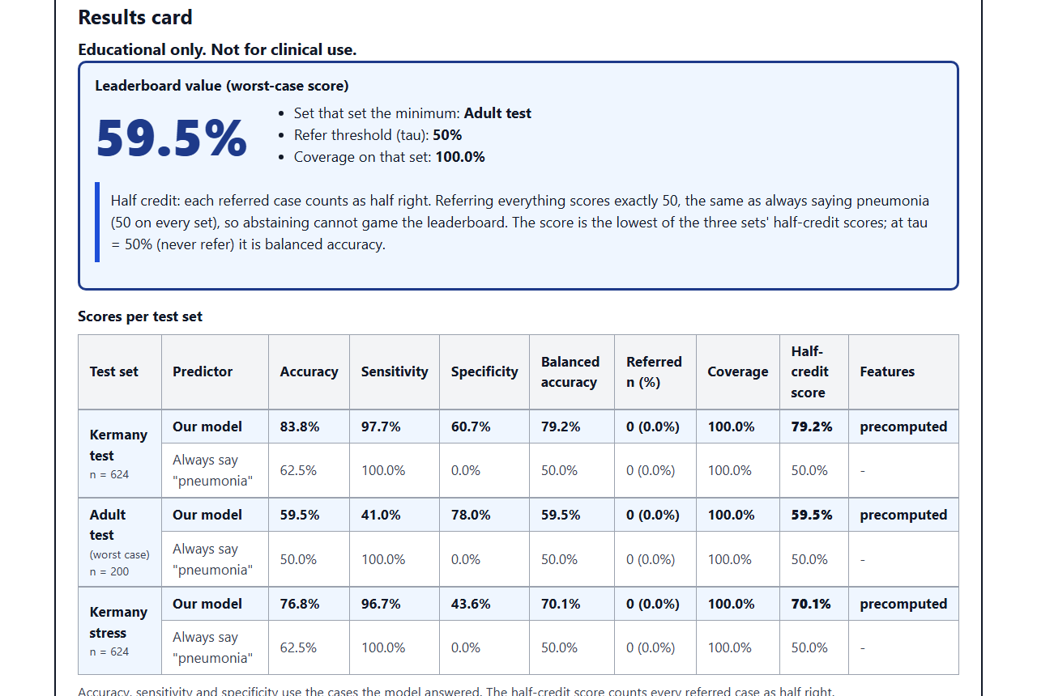
How we use the metrics in the app
DAY 1 · METRICS
THE RESULTS TAB
1
Baseline first
Compare with the “always say pneumonia” row.
2
Two numbers
Read sensitivity and specificity, not accuracy alone.
3
One score: worst case
The lowest balanced accuracy over three test sets: Kermany test, adult test, Kermany stress.
Build a Vision Model, Then Break It · Educational only. Not for clinical use.
22
Notes:
Three habits for the app. First, always look at the baseline row, the model that always says pneumonia, and make sure you beat it. Second, read sensitivity and specificity, not accuracy alone. Third, the results card boils everything down to one number, the worst-case score: the lowest balanced accuracy over three test sets, the Kermany test set, the adult test set and the Kermany stress set, which is the same 624 X-rays made darker, lower in contrast, rotated and cropped. A model is only as good as its worst set. That one number is what goes on the leaderboard on Day 2.

Slide 23
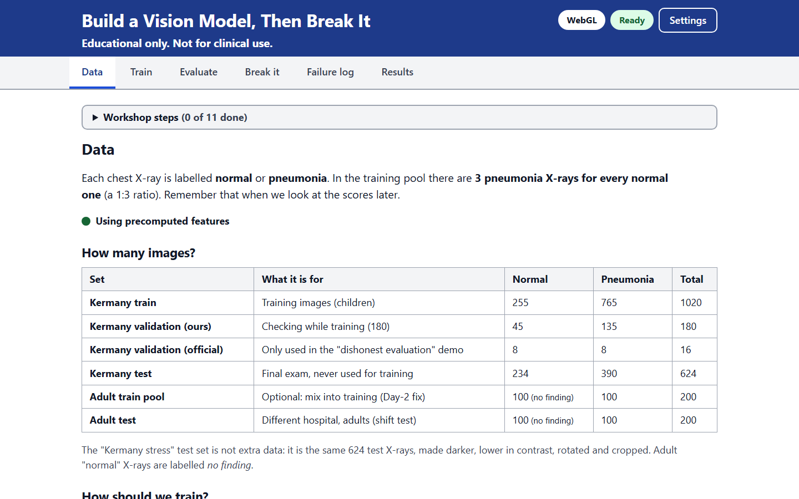
The app: tour, setup and your first model
DAY 1 · HANDS-ON
1
Open the link and allow the camera.
2
Data tab: load the data and count the 3 : 1 ratio.
3
Train tab: train version 1, 20 epochs, a few seconds.
4
Write accuracy, sensitivity and specificity on your results card.
Stuck? Follow the Workshop steps checklist at the top of the app.
Six tabs: Data, Train, Evaluate, Break it, Failure log, Results.
Build a Vision Model, Then Break It · Educational only. Not for clinical use.
23
Notes:
Timing: the hands-on block starts here and runs about 35 minutes through the debrief on slide 25. Give everyone five minutes to open the app: https://akramoo.github.io/vision-break-workshop/ . Show the six tabs, then do the steps live while they follow. Load the data and count the three to one ratio. Train version 1: 20 epochs take a few seconds. Then ask everyone to write accuracy, sensitivity and specificity on their results card, and remind them that the Workshop steps checklist at the top of the app is there whenever they get stuck. If someone has no webcam, they can skip the camera permission and continue.

Slide 24
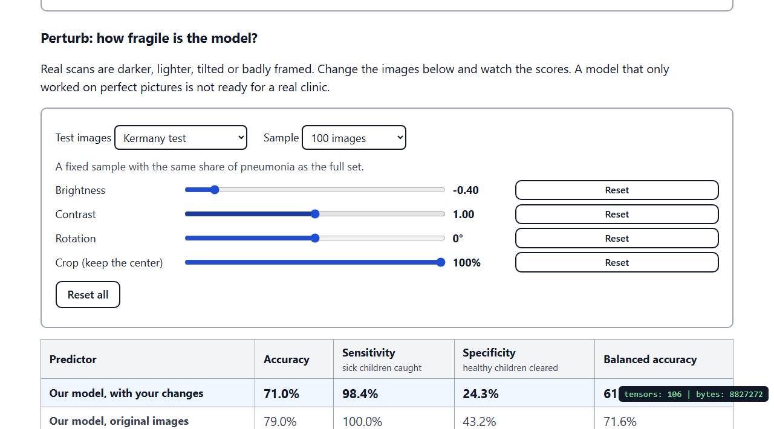
Predict first, then break it
DAY 1 · HANDS-ON
1 · WRITE ONE PREDICTION
BREAK IT TAB: PERTURB
It will fail when… because…
2 · TRY AT LEAST THREE BREAKS
Sliders: darker, tilted, cropped
Upload: pictures that are not X-rays
Webcam: point it at a cup
3 · LOG EVERY FAILURE
Give each one a tag.
Build a Vision Model, Then Break It · Educational only. Not for clinical use.
24
Notes:
Before anyone touches a slider, ask them to write one prediction on paper: it will fail when blank, because blank. Predictions turn random poking into an experiment. Then they try at least three breaks: the sliders in Perturb, uploading pictures that are not X-rays, and the live webcam pointed at a cup. Each failure goes in the failure log with a tag, which is the next slide. Remind them: do not upload your own or family members’ medical images. Images never leave the browser, but do not do it anyway.

Slide 25
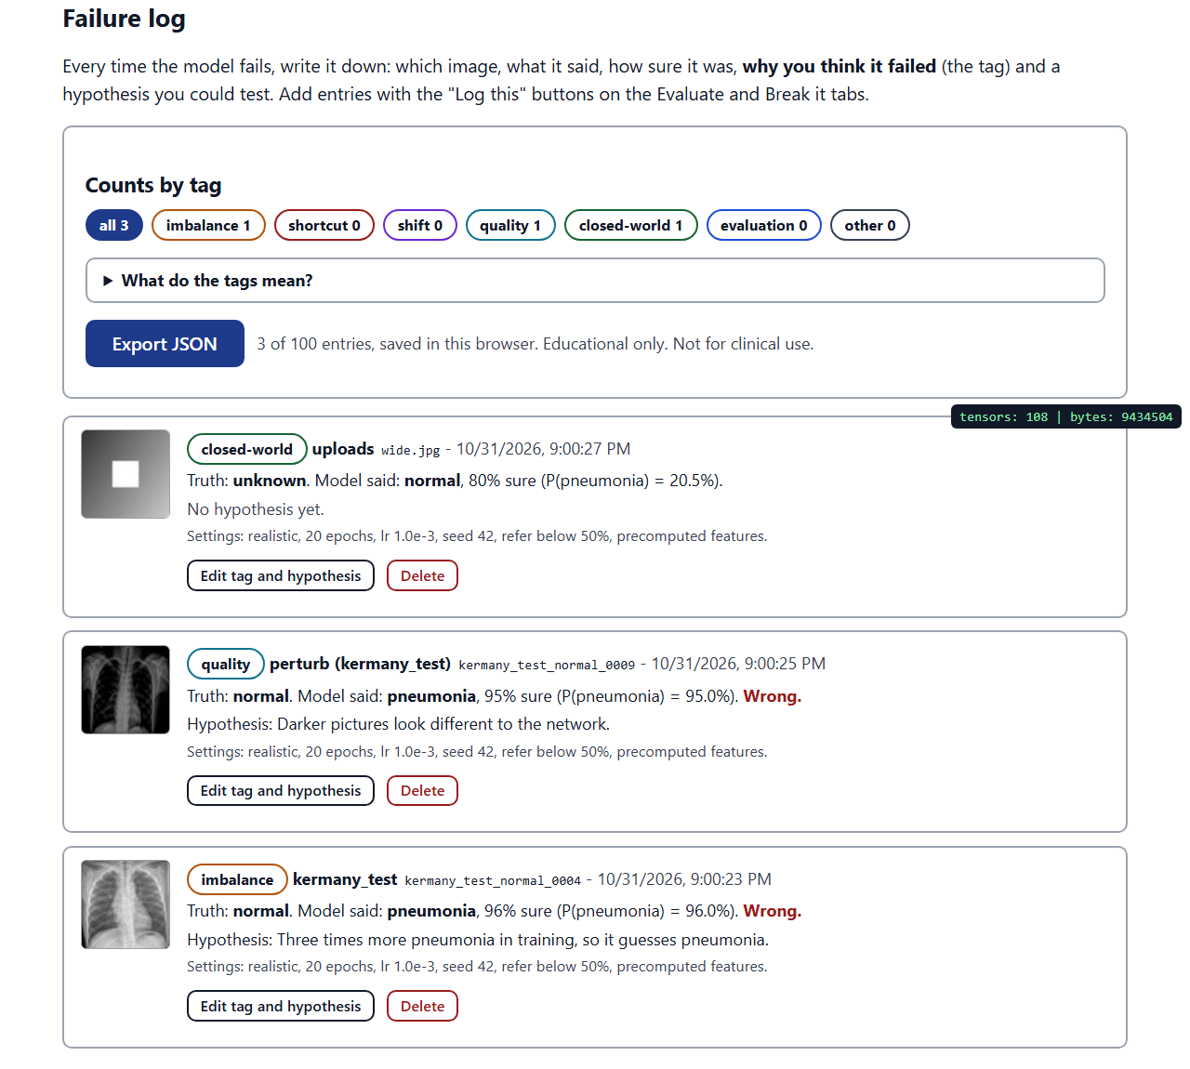
The failure taxonomy: seven tags
DAY 1 · HANDS-ON
Tag | What went wrong
imbalance | One class is far more common in training
shortcut | Learns a marker, not the disease
shift | Test data comes from a different population
quality | Dark, blurry, rotated or cropped images
closed-world | Must pick a class, even for a cup
evaluation | The test itself was dishonest
other | Anything that fits none of the above
THE FAILURE LOG TAB
Build a Vision Model, Then Break It · Educational only. Not for clinical use.
25
Notes:
Every failure gets one of seven tags, so that at the end we can see patterns instead of anecdotes. Imbalance: one class dominates. Shortcut: the model uses something that is not the disease. Shift: the test data comes from a different population. Quality: dark, blurry, rotated or cropped images. Closed-world: the model must pick one of its classes even for something that is neither. Evaluation: the test was dishonest. Other is the honest bucket. Pick the tag you think explains the failure, then write a hypothesis you could test.

Slide 26
A model once learned which hospital, not which disease.
DAY 1 · DEBRIEF
First, one failure each: what did you log? Tomorrow we find out how this can happen.
Build a Vision Model, Then Break It · Educational only. Not for clinical use.
26
Notes:
Close Day 1 with a short debrief, about five minutes. Ask a few people to share one failure from their log: what image, what the model said, which tag. Group them out loud by tag. Then plant the teaser: a model once learned which hospital an X-ray came from, not which disease it showed. Tomorrow we look at how that happens, and we will reproduce a small version of it ourselves. Ask everyone to keep their results card and failure log; Day 2 builds on them.

Slide 27
Recap: a model that learned the hospital
DAY 2 · SHORTCUTS, SHIFT AND THE HUMAN IN THE LOOP
GUESS THE HOSPITAL
HOSPITAL ALONE
PNEUMONIA RATE
99.95%
99.98%
AUC 0.861
34.2%
1.2%
NIH
Mount Sinai
for pneumonia
Mount Sinai
NIH
accuracy at telling which hospital an X-ray came from
sorting X-rays by hospital alone “predicted” pneumonia
of X-rays, by hospital
Question for the room: why would the hospital predict pneumonia?
Source: Zech et al., PLOS Medicine, 2018 · Educational only. Not for clinical use.
27
Notes:
Day 2 starts here: about 1 h 50 in total. Suggested pace: 15 minutes on the shortcut story and the stamp lab, 10 on population shift, 35 on fixes and the leaderboard, 15 on chatbots and the human in the loop, 10 for wrap-up and the quiz. Recap Day 1 in two sentences, then tell the Zech story. In 2018 Zech and colleagues found that a CNN could recognise which hospital an X-ray came from with 99.95 percent accuracy at NIH and 99.98 percent at Mount Sinai. Sorting X-rays by hospital alone predicted pneumonia with an AUC of 0.861. The pneumonia rate was 34.2 percent at Mount Sinai and 1.2 percent at NIH. Now ask the room: why would the hospital predict pneumonia? Let them argue for a minute; the answer is that the model can use the hospital, and everything that comes with it, instead of the lungs.

Slide 28
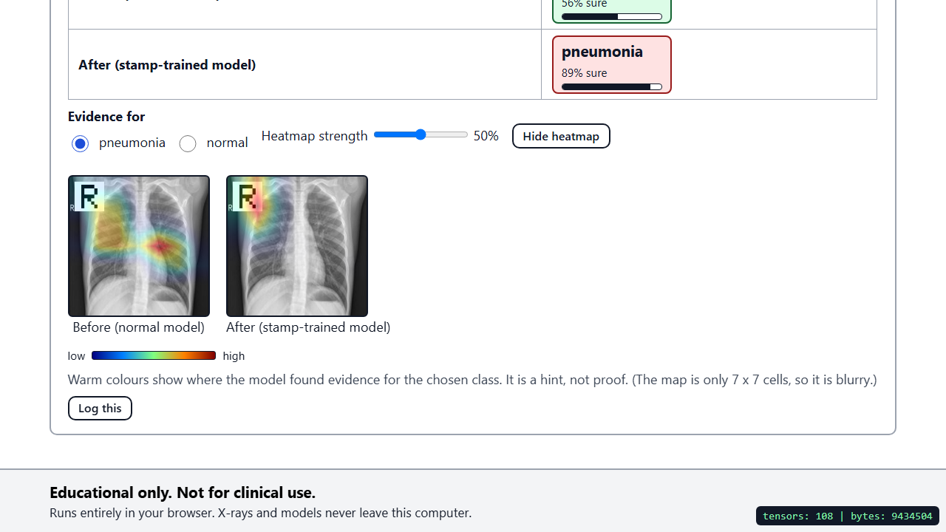
Plant a shortcut: the white “R” stamp
DAY 2 · SHORTCUT LAB
Stamp a small white “R” on pneumonia training images only. Retrain. Then stamp a normal X-ray: it flips.
HEATMAP: BEFORE AND AFTER
93.6%
42%
of normal test X-rays flip to pneumonia (219 of 234)
of unstamped pneumonia is missed by the stamp-trained model
Warm = evidence. A hint, not proof.
Build a Vision Model, Then Break It · Educational only. Not for clinical use.
28
Notes:
This is the lab. In the Break it tab, Stamp, put a small white R marker on the pneumonia training images only and retrain. The model now has an easy rule: marker means pneumonia, no need to look at a lung. Then stamp a normal X-ray and watch the answer flip. Our measured result on the Kermany test set: 93.6 percent of normal X-rays, 219 of 234, flip to pneumonia once stamped, and the stamp-trained model misses 42 percent of unstamped pneumonia. Open the heatmap. Warm colours show where the model found evidence, and for the stamp-trained model that is the marker. Stress that a heatmap is a hint, not proof. Tell the room to log this as a shortcut.

Slide 29
COVID-19 X-ray models took shortcuts too
DAY 2 · SHORTCUTS IN REAL MODELS
SHORTCUT 1
SHORTCUT 2
THE RESULT
Text markers
Patient positioning
Accurate here, failing elsewhere
Letters and labels on the image, not the lungs.
How the patient was placed for the scan.
They looked accurate, then failed in new hospitals.
Same idea as our “R” stamp, found in real models.
Source: DeGrave et al., 2021 (medRxiv) · Educational only. Not for clinical use.
29
Notes:
This is not just a classroom trick. DeGrave and colleagues, 2021, studied AI models for COVID-19 chest X-rays that looked accurate. They found the models were relying on shortcuts such as text markers on the image and how patients were positioned, rather than the disease, and that is why they failed when tested in new hospitals. Keep this qualitative: we are not quoting numbers from the paper here, the point is the pattern. Source: DeGrave et al. 2021, medRxiv, with a University of Washington press release. Ask: what would be your first test to detect a shortcut like this?

Slide 30
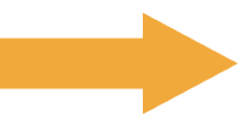
Children from one hospital are not everyone
DAY 2 · NEW POPULATIONS
KERMANY TEST · CHILDREN
ADULT TEST · ANOTHER HOSPITAL
82.4%
51.5%
accuracy, same hospital as training
accuracy, adults from NIH
−30.9 points
Adult specificity: 13%
Distribution shift: the new data looks different from the training data, so the score drops.
Build a Vision Model, Then Break It · Educational only. Not for clinical use.
30
Notes:
Now we move the model to a new population. On the Kermany test set, children from the same hospital as the training data, accuracy is 82.4 percent. On the adult test set from NIH it falls to 51.5 percent, a drop of 30.9 points, and adult specificity is only 13 percent: most healthy adults get flagged as pneumonia. Nothing is wrong with the code. The data changed. That is distribution shift: the new data differs from the data the model learned from. Ask: who would have discovered this if we had only reported the first number?

Slide 31
Four fixes, one worst-case score
DAY 2 · FIX IT AND RE-MEASURE
1
Balance the classes
WORST RESULT ACROSS THE 3 TEST SETS
2
Augment the images
Baseline
3
Mix in adult X-rays
51.5
Balanced classes
4
Add an abstain threshold: “Refer to a doctor”
51.5
+ adult X-rays mixed in
Apply at least two fixes, re-measure, save a snapshot.
59.5
+ augmentation
59.0
Refer at 80% sure (safety, not score)
56.0
Build a Vision Model, Then Break It · Educational only. Not for clinical use.
31
Notes:
Timing: the fix lab is about 35 minutes together with the leaderboard. Four fixes to try in the Train and Break it tabs: balance the classes, augment the images, mix in adult X-rays, and add an abstain threshold so the model can say refer to a doctor. The score is the worst result across the three test sets. Our measured sequence on a typical run: baseline 51.5, balanced classes 51.5, adding adult X-rays 59.5, adding augmentation 59.0. Referring everything below 80 percent sure scores 56.0: that is about safety, not about score, because referred cases only get half credit. The bars start at zero on purpose. Ask everyone to apply at least two fixes, re-measure on every test set, and save a snapshot before and after. Your numbers may differ slightly.

Slide 32
Leaderboard
DAY 2 · FIX IT AND RE-MEASURE
Rank | Name | Worst-case score | Weakest set | Fixes used
1 | [name] | [score] | [set] | [fixes]
2 | [name] | [score] | [set] | [fixes]
3 | [name] | [score] | [set] | [fixes]
4 | [name] | [score] | [set] | [fixes]
5 | [name] | [score] | [set] | [fixes]
Post the worst-case score from your Results tab: the lowest balanced accuracy over the three test sets.
Build a Vision Model, Then Break It · Educational only. Not for clinical use.
32
Notes:
Collect scores live: each person reads the worst-case score from the Results tab, says which set was their weakest and which fixes they used, and you type them into this table, replacing the bracketed placeholders. Celebrate the fixes, not only the winner. Ask the top scorer what surprised them, and ask anyone whose score went down after a fix to explain why; those are the most instructive cases. Remind everyone that referring cases to a doctor cannot raise the leaderboard score, because referred cases only earn half credit.

Slide 33
Big chatbots are not immune
DAY 2 · THE HUMAN IN THE LOOP
TEST SET 1 · JMIR PREPRINT, 20,000 COVID-PNEUMONIA X-RAYS
TEST SET 2 · BALANCED, 400 IMAGES
74%
45%
61.2%
54.1%
GPT-4o, image only, at best
Gemini 2.0
GPT-4o
GPT-4 Turbo
Different test sets: never read these numbers as one ranking.
Discussion: specialist model, chatbot, or both with a human?
Source: JMIR preprint · Educational only. Not for clinical use.
33
Notes:
Timing: this block and the next take about 15 minutes. General-purpose chatbots look impressive, but they are not magic. A JMIR preprint tested chatbots on 20,000 COVID-pneumonia X-rays and reported 45 percent for Gemini 2.0, 61.2 percent for GPT-4o and 54.1 percent for GPT-4 Turbo. On a different, balanced 400-image test, GPT-4o with the image only reached 74 percent at best. These come from different test sets, so never compare them as one ranking; the point is only that scores depend on the test. Open the discussion: would you use a specialist model, a chatbot, or both with a human checking? Let two or three people argue each side.

Slide 34
AI proposes, the doctor decides
DAY 2 · THE HUMAN IN THE LOOP
THE CLOSED-WORLD PROBLEM
The model must pick a class, even for a photo of a cup. A threshold lets it say “Refer to a doctor”.
MY STORY
[your story here: audit trail, PathOS]
6 of 6
4 of 6
Who checked the AI, and what was recorded?
non-X-ray pictures called pneumonia
of them at 90% sure or more
Build a Vision Model, Then Break It · Educational only. Not for clinical use.
34
Notes:
Two ideas. First, the closed-world problem: our model was only ever taught pneumonia and normal, so for a photo of a cup it still has to pick one. In our dry run, six non-X-ray pictures were all called pneumonia, four of them at 90 percent sure or more. A confidence threshold lets the model say refer to a doctor instead of answering, which is why that option exists in the app. Second, tell your own story here about audit trails and the human decision, using the PathOS example, and replace the placeholder before presenting. The takeaway: the AI proposes, a person decides, and the system keeps a record of both.

Slide 35
Five things to remember
DAY 2 · WRAP-UP
1
Baseline first
Beat the model that never looks at the picture.
2
Accuracy lies
Read sensitivity and specificity when classes are unequal.
3
Models learn shortcuts
A marker or a hospital can stand in for the disease.
4
Test on new populations
Report the worst result, not the best.
5
Keep a human in the loop
The model proposes, the doctor decides.
Build a Vision Model, Then Break It · Educational only. Not for clinical use.
35
Notes:
Wrap-up, about five minutes. If they remember only five things, they should be these. One: always start from a baseline. Two: accuracy lies when classes are unequal, so read sensitivity and specificity. Three: models learn shortcuts, markers, hospitals, positioning. Four: test on new populations and report your worst result, not your best. Five: keep a human in the loop. Say each one aloud and tie it to a moment from the two days: the three-to-one data, the R stamp, the drop from children to adults, the cup.

Slide 36
Quiz: four questions
DAY 2 · SAME QUIZ BEFORE AND AFTER
1
A model scores 90% accuracy. Is that good?
2
What does sensitivity mean here?
3
A model learns a hospital’s marker instead of the disease. What is this called?
4
It works on children from one hospital. Will it work on adults from another?
[QR code]
FEEDBACK FORM
[feedback form link]
Build a Vision Model, Then Break It · Educational only. Not for clinical use.
36
Notes:
Use the same four questions you asked at the start of Day 1, if you ran a pre-quiz, so the room can see what changed. Suggested answers. One: not necessarily; compare with the baseline and check sensitivity and specificity, because with unequal classes 90 percent can be easy. Two: the share of sick children the model catches. Three: a shortcut. Four: not guaranteed; that is distribution shift, and you have to test it. Then share the feedback form link and QR code, replacing the placeholders before presenting, and thank everyone.

Slide 37
Sources and credits
CREDITS
DATA AND MODELS
STUDIES AND CODE
Kermany et al., Cell, 2018 · CC BY 4.0 · doi 10.1016/j.cell.2018.02.010
Zech et al., PLOS Medicine, 2018
DeGrave et al., 2021 · medRxiv
Mendeley Data · doi 10.17632/rscbjbr9sj.3
JMIR preprint on chatbots reading chest X-rays · [add full citation]
MedMNIST v2 · Yang et al., Scientific Data, 2023
NIH ChestX-ray14 · Wang et al., CVPR 2017 · CC0
Workshop code: https://github.com/akramoo/vision-break-workshop
MobileNetV2 · Sandler et al., CVPR 2018 · Apache-2.0
App: https://akramoo.github.io/vision-break-workshop/
Educational only. Not for clinical use.
Thank you · Build a Vision Model, Then Break It · Educational only. Not for clinical use.
37
Notes:
Leave this up while people pack up or ask questions. All datasets used here are openly licensed: Kermany under CC BY 4.0, ChestX-ray14 under CC0, and MobileNetV2 under Apache-2.0. The code and the app are public at the addresses shown. Finish by repeating the disclaimer: everything in this workshop is educational only and not for clinical use. Add the full citation for the JMIR preprint in place of the placeholder before presenting.

